Slide 1
Chapter 16
Web Engineering

Slide 2
Web Applications
WebApps encompass:
  complete Web sites
    Simple information Web sites
    Complex e-Commerce of other sites with embedded functionality and data retrieval
    Complex Web sites that are interoperable with other legacy software and systems
  specialized functionality within Web sites
  information processing applications that reside on the Internet or on an intranet or ExtraNet.

Slide 3
WebApp Attributes—I
Network intensiveness. A WebApp resides on a network and must serve the needs of a diverse community of clients.
Concurrency. A large number of users may access the WebApp at one time; patterns of usage among end-users will vary greatly.
Unpredictable load. The number of users of the WebApp may vary by orders of magnitude from day to day.
Performance. If a WebApp user must wait too long (for access, for server-side processing, for client-side formatting and display), he or she may decide to go elsewhere.

Slide 4
WebApp Attributes—II
Availability. Although expectation of 100 percent availability is unreasonable, users of popular WebApps often demand access on a “24/7/365” basis.
Data driven. The primary function of many WebApps is to use hypermedia to present text, graphics, audio, and video content to the end-user.
Content sensitive. The quality and aesthetic nature of content remains an important determinant of the quality of a WebApp.
Continuous evolution. Unlike conventional application software that evolves over a series of planned, chronologically-spaced releases, Web applications evolve continuously.

Slide 5
WebApp Attributes—III
Immediacy. WebApps often exhibit a time to market that can be a matter of a few days or weeks.
  With modern tools, sophisticated Web pages can be produced in only a few hours.
Security. In order to protect sensitive content and provide secure modes of data transmission, strong security measures must be implemented throughout the infrastructure that supports a WebApp and within the application itself.
Aesthetics. When an application has been designed to market or sell products or ideas, aesthetics may have as much to do with success as technical design.

Slide 6
WebApp Categories
informational—read-only content is provided with simple navigation and links
download—a user downloads information from the appropriate server
customizable—the user customizes content to specific needs
interaction—communication among a community of users occurs via chatroom, bulletin boards, or instant messaging
user input—forms-based input is the primary mechanism for communicating need
transaction-oriented—the user makes a request (e.g., places an order) that is fulfilled by the WebApp
service-oriented—the application provides a service to the user, e.g., assists the user in determining a mortgage payment
Portal—the application channels the user to other Web content or services outside the domain of the portal application
database access—the user queries a large database and extracts information
data warehousing—the user queries a collection of large databases and extracts information

Slide 7
Web Engineering
“Web development is an adolescent … Like most adolescents, it wants to be accepted as an adult as it tries to pull away from its parents. If it is going to reach its full potential, it must take a few lessons from the more seasoned world of software development.”
Doug Wallace et al

Slide 8
The WebE Process
Must accommodate:
  Incremental delivery
  Frequent changes
  Short timeline
Therefore,
  An incremental process model (Chapters 3 and 4) should be used in virtually all situations
  An agile process model (Chapter) is appropriate in many situations

Slide 9
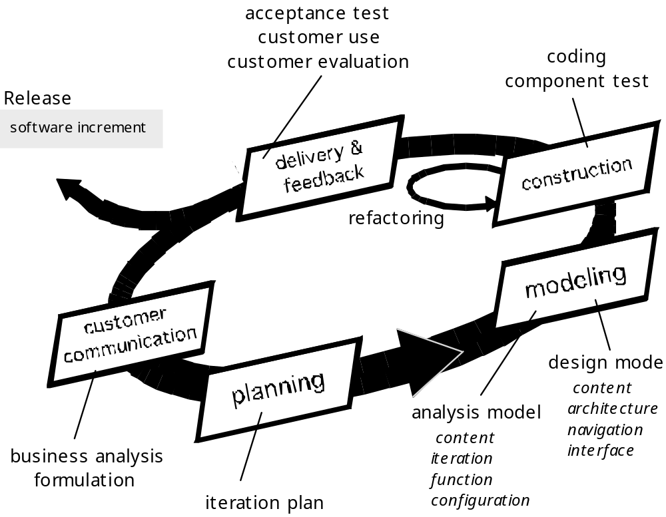
The WebE Process

Slide 10
The WebE Process Framework—I
Customer communication
  Business analysis defines the business/organizational context for the WebApp.
  Formulation is a requirements gathering activity involving all stakeholders. The intent is to describe the problem that the WebApp is to solve
Planning
  The “plan” consists of a task definition and a timeline schedule for the time period (usually measured in weeks) projected for the development of the WebApp increment.

Slide 11
The WebE Process Framework—II
Modeling
  Analysis model—establishes a basis for design
    Content Analysis.
    Interaction Analysis.
    Functional Analysis.
    Configuration Analysis.
  Design model—represents key WebApp elements
    Content design
    Aesthetic design
    Architectural design
    Interface design
    Navigation design
    Component design

Slide 12
The WebE Process Framework—III
Construction
  WebE tools and technology are applied to construct the WebApp that has been modeled
  Testing of all design elements
Delivery and Evaluation (Deployment)
  configure for its operational environment
  deliver to end-users, and
  Evaluation feedback is presented to the WebE team
  the increment is modified as required (the beginning of the next incremental cycle)

Slide 13
WebE—Basic Questions
How important is a Web site home page?
What is the most effective page layout (e.g., menu on top, on the right or left?) and does it vary depending upon the type of WebApp being developed?
Which media options have the most impact?
How much work can we expect a user to do when he or she is looking for information?
How important are navigational aids when WebApps are complex?
How complex can forms input be before it becomes irritating for the user? How can forms input be expedited?
How important are search capabilities?
Will the WebApp be designed in a manner that makes it accessible to those who have physical or other disabilities?
Susan Weinshenk

Slide 14
WebE—Best Practices
Take the time to understand the business needs and product objectives, even if the details of the WebApp are vague.
Describe how users will interact with the WebApp using a scenario-based approach
Develop a project plan, even it its very brief.
Spend some time modeling what it is that you’re going to build.
Review the models for consistency and quality.
Use tools and technology that enable you to construct the system with as many reusable components as possible.
Don’t rely on early users to debug the WebApp—design comprehensive tests and execute them before releasing the system.

Slide 15
Chapter 17
Formulation and Planning for
Web Engineering

Slide 16
Formulation
begins with the identification of business need
moves into a description of WebApp objectives
defines major features and functions
establishes a requirements gathering activity that will lead to the development of an analysis model
allows stakeholders and the web engineering team to establish a common set of goals and objectives for the construction of the WebApp.
  identifies the scope of the development effort
  provides a means for determining a successful, outcome..

Slide 17
Formulation Questions
What is the main motivation (business need) for the WebApp?
What are the objectives that the WebApp must fulfill?
Who will use the WebApp?
Answers provide …
Informational goals—indicate an intention to provide specific content and/or information for the end-user
Applicative goals—indicate the ability to perform some task within the WebApp

Slide 18
WebE Requirements Gathering
Ask stakeholders to define user categories and develop descriptions for each category
Communicate with stakeholders to define basic WebApp requirements
Analyze information gathered and use information to follow-up with stakeholders
Define use-cases (Chapter 8) that describe interaction scenarios for each user class

Slide 19
Defining User Categories
What is the user’s overall objective when using the WebApp?
What is the user’s background and sophistication relative to the content and functionality of the WebApp?
How will the use arrive at the WebApp?
What generic WebApp characteristics does the user like/dislike?

Slide 20
Communicating with Stakeholders
Traditional focus groups—a trained moderator meets with a small group of representative end-users (or internal stakeholders playing the role of end-users).
Electronic focus groups—a moderated electronic discussion conducted with a group of representative end-users and stakeholders.
Iterative surveys—a series of brief surveys, addressed to representative users and requesting answers to specific questions about the WebApp
Exploratory surveys—a Web-based survey that is tied to one or more WebApps that have users who are similar to the ones that will use the WebApp to be developed.
Scenario-building—selected user are asked to create informal use-cases that describe specific interactions with the WebApp.

Slide 21
Preliminary Analysis
Categorize information gathered by user class and transaction type
Develop lists of …
  content objects
  operations that are applied to content objects within a specific user transaction
  functions (e.g., informational, computational, logical, and help-oriented) that the WebApp provides for end-users
  other non-functional requirements that are noted during the communication activities.

Slide 22
Use-Cases
Provide the detail necessary to create an effective analysis model
Help the developer to understand how users perceive their interaction with the WebApp
Use-cases help to compartmentalize Web engineering work
Use-cases provide important guidance for those who must test the WebApp

Slide 23
The WebE Team
WebE team roles
  Content Developer/Providers
  Web Publisher
  Web Engineer.
  Business domain experts
  Support Specialist
  Administrator (a.k.a. “Web Master”)

Slide 24
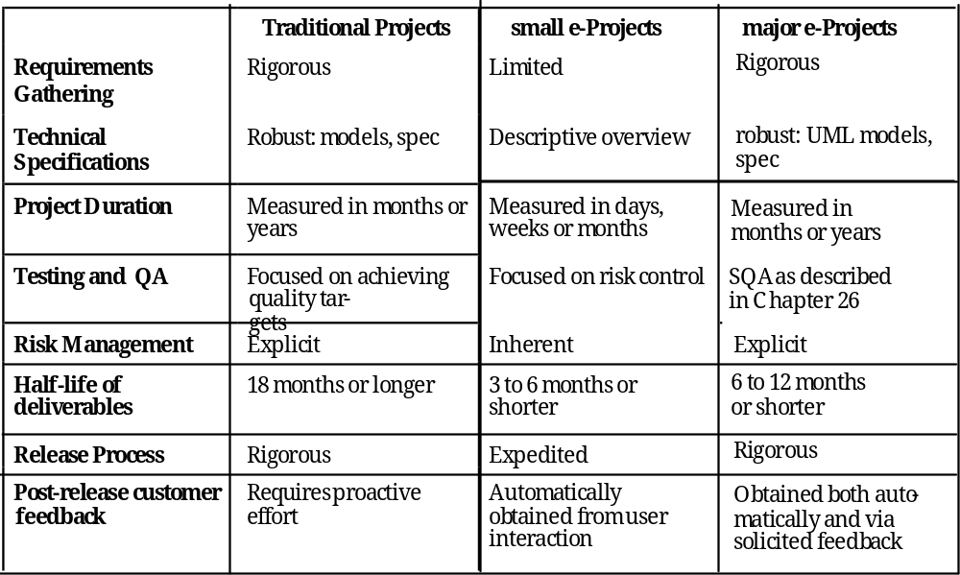
Project Differences

Slide 25
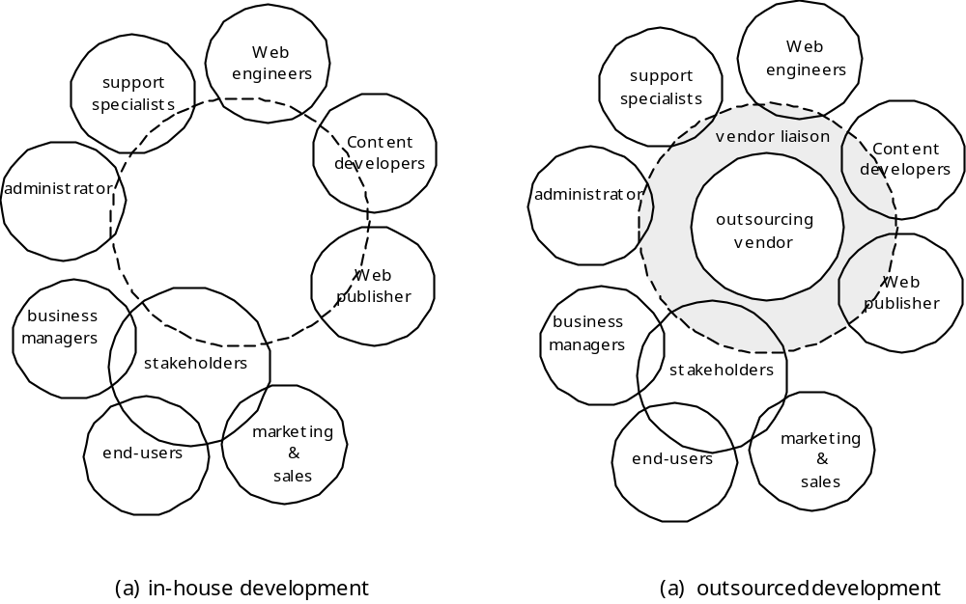
Outsourcing vs. In-house

Slide 26
WebApp Outsourcing - I
Initiate the project by performing the following tasks internally
  Gather requirements
  Develop a “rough design”
  Develop a rough schedule with delivery dates
    Consider increments
  Make a list of responsibilities
    For in-house staff
    For outsourcing vendor
  Define liaison mechanisms

Slide 27
WebApp Outsourcing - II
Select Candidate Outsourcing Vendors
Assess the Validity of Price Quotes and the Reliability of Estimates
  Does the quoted cost of the WebApp provide a direct or indirect return-on-investment that justifies the project?
  Does the vendor that has provided the quote exhibit the professionalism and experience we require?
Understand the Degree of Project Management You Can Expect/Perform
Assess the Development Schedule
Manage Scope

Slide 28
WebApp Planning - In-House
Understand scope, the dimensions of change, and project constraints
Define an incremental project strategy
Perform risk analysis
Develop a quick estimate
Select a task set (process description)
Establish a schedule
Define project tracking mechanisms
Establish a change management approach

Slide 29
WebE “Worst Practices”
We have a great idea, so lets begin building the WebApp—now.
Stuff will change constantly, so there’s no point in trying to understand WebApp requirements.
Developers whose dominant experience has been in traditional software development can develop WebApps immediately. No new training is required.
Be bureaucratic.
Testing? Why bother?

Slide 30
Chapter 18
Analysis Modeling for WebApps

Slide 31
Analysis
Content Analysis. The full spectrum of content to be provided by the WebApp is identified, including text, graphics and images, video, and audio data. Data modeling can be used to identify and describe each of the data objects.
Interaction Analysis. The manner in which the user interacts with the WebApp is described in detail. Use-cases can be developed to provide detailed descriptions of this interaction.
Functional Analysis. The usage scenarios (use-cases) created as part of interaction analysis define the operations that will be applied to WebApp content and imply other processing functions. All operations and functions are described in detail.
Configuration Analysis. The environment and infrastructure in which the WebApp resides are described in detail.

Slide 32
When Do We Perform Analysis?
In some WebE situations, analysis and design merge. However, an explicit analysis activity occurs when …
  the WebApp to be built is large and/or complex
  the number of stakeholders is large
  the number of Web engineers and other contributors is large
  the goals and objectives (determined during formulation) for the WebApp will effect the business’ bottom line
  the success of the WebApp will have a strong bearing on the success of the business

Slide 33
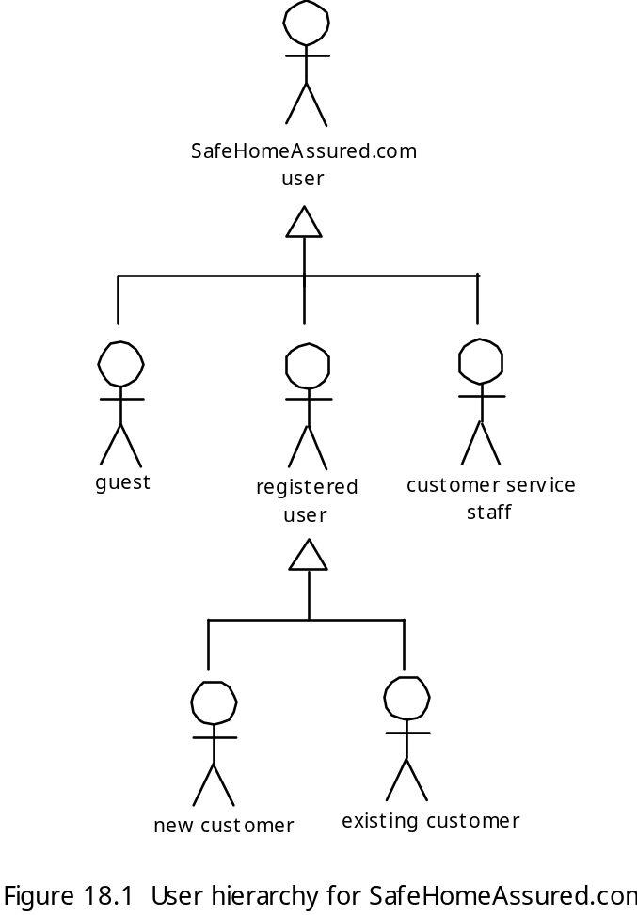
The User Hierarchy

Slide 34
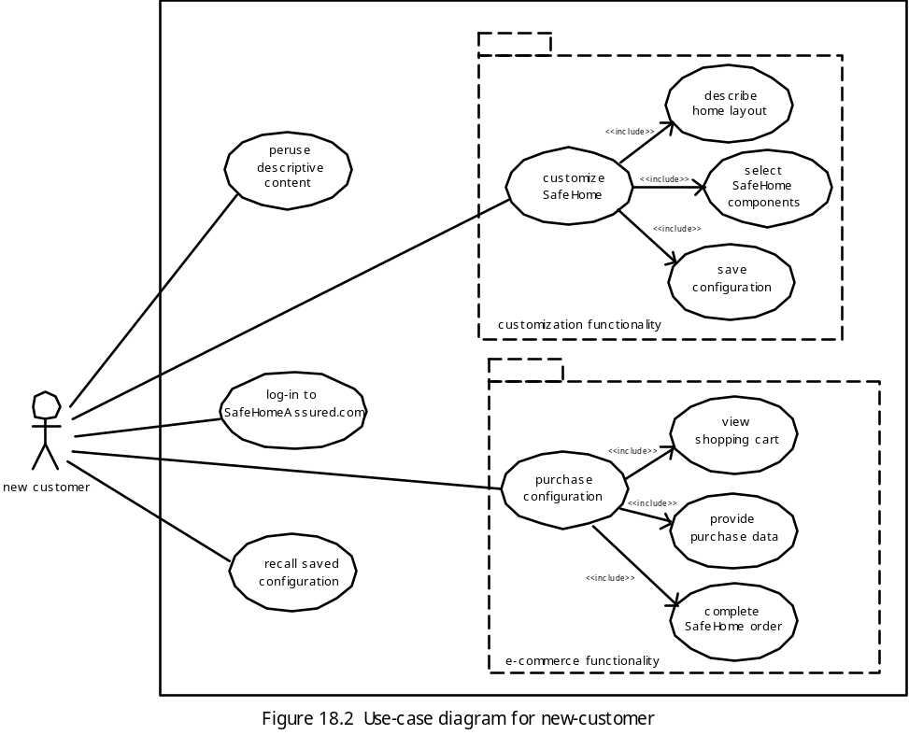
Use-Case Diagram

Slide 35
Refining the Use-Case Model
Use-cases are organized into functional packages
Each package is assessed [CON00] to ensure that it is:
  Comprehensible—all stakeholders understand the purpose of the package
  Cohesive—the package addresses functions that are closely related to one another
  Loosely coupled—functions or classes within the package collaborate with one another, but collaboration outside the package are kept to a minimum.
  Hierarchically shallow—deep functional hierarchies are difficult to navigate and hard for end-users to understand; therefore, the number of levels within a use-case hierarchy should be minimized whenever possible.

Slide 36
The Content Model
Content objects are extracted from use-cases
  examine the scenario description for direct and indirect references to content
Attributes of each content object are identified
The relationships among content objects and/or the hierarchy of content maintained by a WebApp
  Relationships—entity-relationship diagram or UML
  Hierarchy—data tree or UML

Slide 37
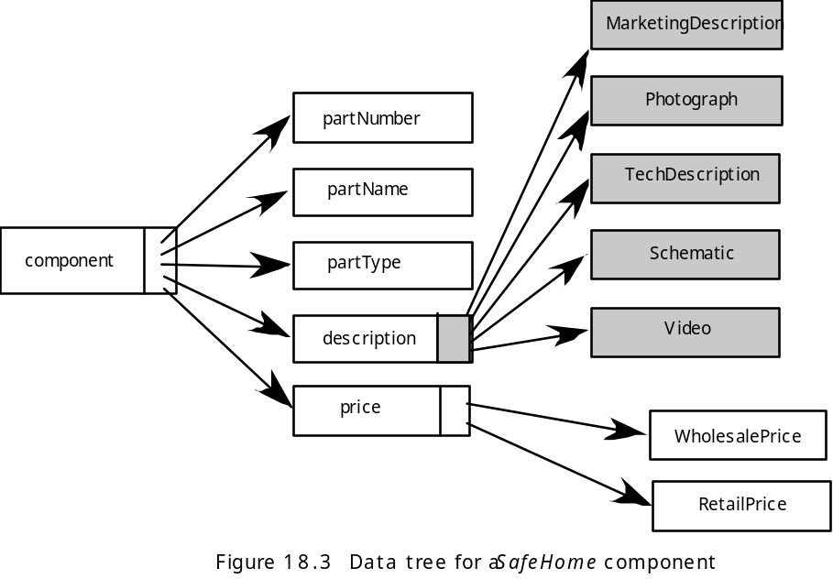
Data Tree

Slide 38
Analysis Classes
Analysis classes are derived by examining each use-case
A grammatical parse is used to identify candidate classes
A UML class diagram is developed for each analysis class

Slide 39
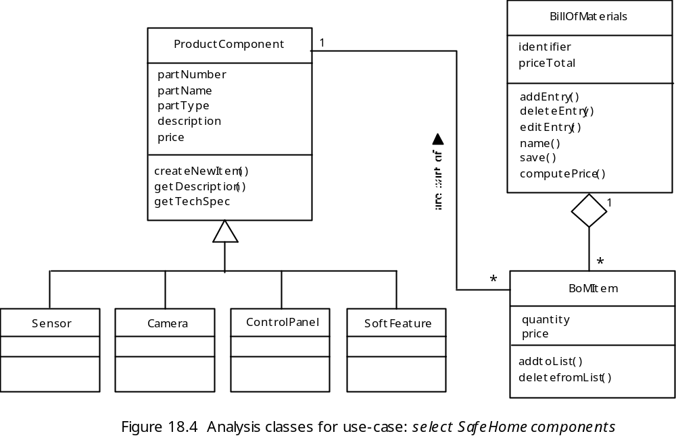
Analysis Class Example

Slide 40
The Interaction Model
Composed of four elements:
  use-cases
  sequence diagrams
  state diagrams
  a user interface prototype
Each of these is an important UML notation and has been described in Chapter 8

Slide 41
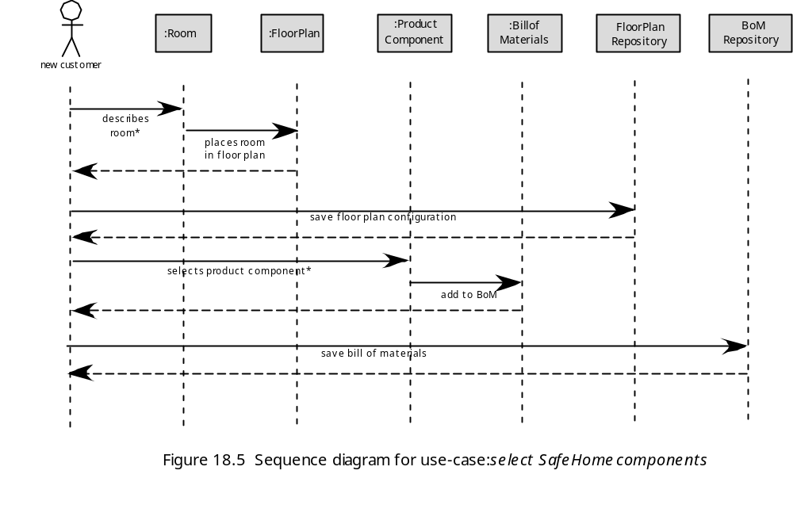
Sequence Diagram

Slide 42
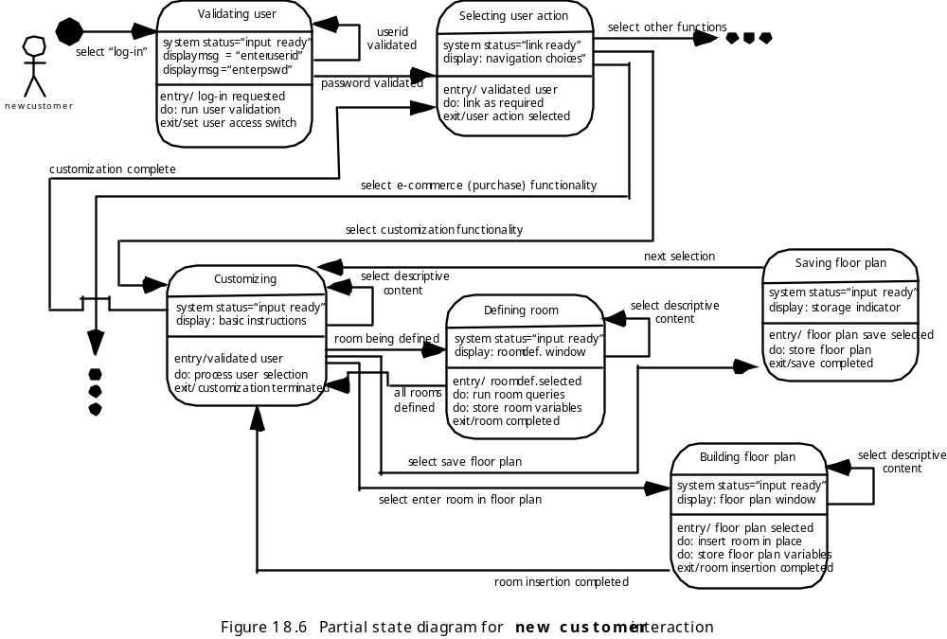
State Diagram

Slide 43
The Functional Model
The functional model addresses two processing elements of the WebApp
  user observable functionality that is delivered by the WebApp to end-users
  the operations contained within analysis classes that implement behaviors associated with the class.
An activity diagram can be used to represent processing flow

Slide 44
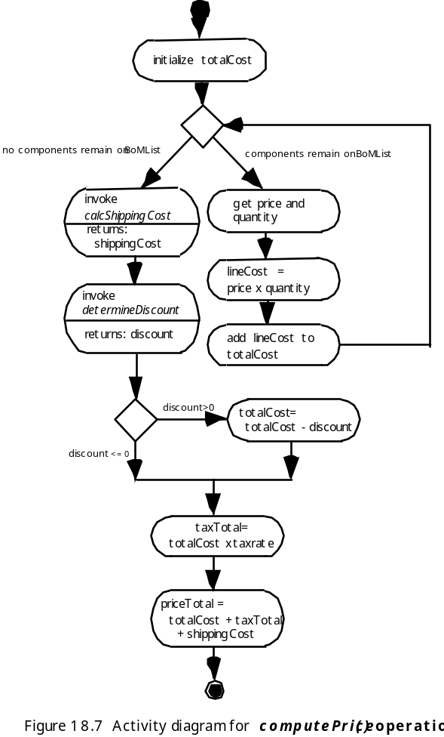
Activity Diagram

Slide 45
The Configuration Model
Server-side
  Server hardware and operating system environment must be specified
  Interoperability considerations on the server-side must be considered
  Appropriate interfaces, communication protocols and related collaborative information must be specified
Client-side
  Browser configuration issues must be identified
  Testing requirements should be defined

Slide 46
Relationship-Navigation Analysis
Relationship-navigation analysis (RNA) identifies relationships among the elements uncovered as part of the creation of the analysis model
Steps:
  Stakeholder analysis—identifies the various user categories and establishes an appropriate stakeholder hierarchy
  Element analysis—identifies the content objects and functional elements that are of interest to end users
  Relationship analysis—describes the relationships that exist among the WebApp elements
  Navigation analysis—examines how users might access individual elements or groups of elements
  Evaluation analysis—considers pragmatic issues (e.g., cost/benefit) associated with implementing the relationships defined earlier

Slide 47
Navigation Analysis-I
Should certain elements be easier to reach (require fewer navigation steps) than others? What is the priority for presentation?
Should certain elements be emphasized to force users to navigate in their direction?
How should navigation errors be handled?
Should navigation to related groups of elements be given priority over navigation to a specific element.
Should navigation be accomplished via links, via search-based access, or by some other means?
Should certain elements be presented to users based on the context of previous navigation actions?
Should a navigation log be maintained for users?

Slide 48
Navigation Analysis-II
Should a full navigation map or menu (as opposed to a single “back” link or directed pointer) be available at every point in a user’s interaction?
Should navigation design be driven by the most commonly expected user behaviors or by the perceived importance of the defined WebApp elements?
Can a user “store” his previous navigation through the WebApp to expedite future usage?
For which user category should optimal navigation be designed?
How should links external to the WebApp be handled? overlaying the existing browser window? as a new browser window? as a separate frame?

Slide 49
Chapter 19
Design Modeling for WebApps

Slide 50
Design & WebApps
“There are essentially two basic approaches to design: the artistic ideal of expressing yourself and the engineering ideal of solving a problem for a customer.”
Jakob Nielsen
When should we emphasize WebApp design?
  when content and function are complex
  when the size of the WebApp encompasses hundreds of content objects, functions, and analysis classes
  when the success of the WebApp will have a direct impact on the success of the business

Slide 51
Design & WebApp Quality
Security
  Rebuff external attacks
  Exclude unauthorized access
  Ensure the privacy of users/customers
Availability
  the measure of the percentage of time that a WebApp is available for use
Scalability
  Can the WebApp and the systems with which it is interfaced handle significant variation in user or transaction volume
Time to Market

Slide 52
Quality Dimensions for End-Users
Time
  How much has a Web site changed since the last upgrade?
  How do you highlight the parts that have changed?
Structural
  How well do all of the parts of the Web site hold together.
  Are all links inside and outside the Web site working?
  Do all of the images work?
  Are there parts of the Web site that are not connected?
Content
  Does the content of critical pages match what is supposed to be there?
  Do key phrases exist continually in highly-changeable pages?
  Do critical pages maintain quality content from version to version?
  What about dynamically generated HTML pages?

Slide 53
Quality Dimensions for End-Users
Accuracy and Consistency
  Are today's copies of the pages downloaded the same as yesterday's? Close enough?
  Is the data presented accurate enough? How do you know?
Response Time and Latency
  Does the Web site server respond to a browser request within certain parameters?
  In an E-commerce context, how is the end to end response time after a SUBMIT?
  Are there parts of a site that are so slow the user declines to continue working on it?
Performance
  Is the Browser-Web-Web site-Web-Browser connection quick enough?
  How does the performance vary by time of day, by load and usage?
  Is performance adequate for E-commerce applications?

Slide 54
WebApp Design Goals
Consistency
  Content should be constructed consistently
  Graphic design (aesthetics) should present a consistent look across all parts of the WebApp
  Architectural design should establish templates that lead to a consistent hypermedia structure
  Interface design should define consistent modes of interaction, navigation and content display
  Navigation mechanisms should be used consistently across all WebApp elements

Slide 55
WebApp Design Goals
Identity
  Establish an “identity” that is appropriate for the business purpose
Robustness
  The user expects robust content and functions that are relevant to the user’s needs
Navigability
  designed in a manner that is intuitive and predictable
Visual appeal
  the look and feel of content, interface layout, color coordination, the balance of text, graphics and other media, navigation mechanisms must appeal to end-users
Compatibility
  With all appropriate environments and configurations

Slide 56
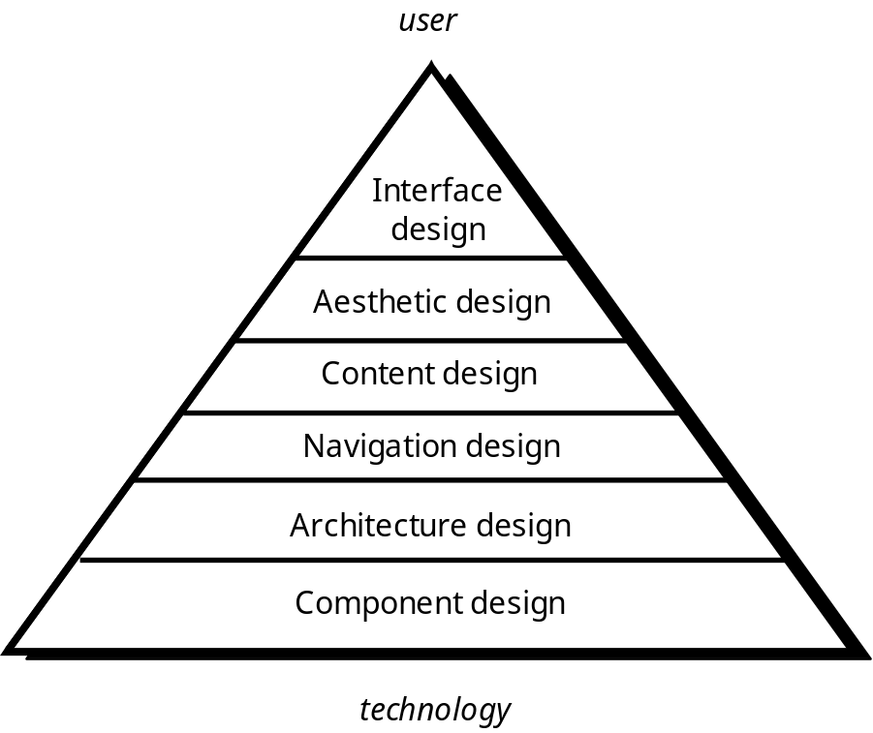
WebE Design Pyramid

Slide 57
WebApp Interface Design
Where am I? The interface should
  provide an indication of the WebApp that has been accessed
  inform the user of her location in the content hierarchy.
What can I do now? The interface should always help the user understand his current options
  what functions are available?
  what links are live?
  what content is relevant?
Where have I been, where am I going? The interface must facilitate navigation.
  Provide a “map” (implemented in a way that is easy to understand) of where the user has been and what paths may be taken to move elsewhere within the WebApp.

Slide 58
Effective WebApp Interfaces
Bruce Tognozzi [TOG01] suggests…
  Effective interfaces are visually apparent and forgiving, instilling in their users a sense of control. Users quickly see the breadth of their options, grasp how to achieve their goals, and do their work.
  Effective interfaces do not concern the user with the inner workings of the system. Work is carefully and continuously saved, with full option for the user to undo any activity at any time.
  Effective applications and services perform a maximum of work, while requiring a minimum of information from users.

Slide 59
Interface Design Principles-I
Anticipation—A WebApp should be designed so that it anticipates the use’s next move.
Communication—The interface should communicate the status of any activity initiated by the user
Consistency—The use of navigation controls, menus, icons, and aesthetics (e.g., color, shape, layout)
Controlled autonomy—The interface should facilitate user movement throughout the WebApp, but it should do so in a manner that enforces navigation conventions that have been established for the application.
Efficiency—The design of the WebApp and its interface should optimize the user’s work efficiency, not the efficiency of the Web engineer who designs and builds it or the client-server environment that executes it.

Slide 60
Interface Design Principles-II
Focus—The WebApp interface (and the content it presents) should stay focused on the user task(s) at hand.
Fitt’s Law—“The time to acquire a target is a function of the distance to and size of the target.”
Human interface objects—A vast library of reusable human interface objects has been developed for WebApps.
Latency reduction—The WebApp should use multi-tasking in a way that lets the user proceed with work as if the operation has been completed.
Learnability— A WebApp interface should be designed to minimize learning time, and once learned, to minimize relearning required when the WebApp is revisited.

Slide 61
Interface Design Principles-III
Maintain work product integrity—A work product (e.g., a form completed by the user, a user specified list) must be automatically saved so that it will not be lost if an error occurs.
Readability—All information presented through the interface should be readable by young and old.
Track state—When appropriate, the state of the user interaction should be tracked and stored so that a user can logoff and return later to pick up where she left off.
Visible navigation—A well-designed WebApp interface provides “the illusion that users are in the same place, with the work brought to them.”

Slide 62
Interface Design Workflow-I
Review information contained in the analysis model and refine as required.
Develop a rough sketch of the WebApp interface layout.
Map user objectives into specific interface actions.
Define a set of user tasks that are associated with each action.
Storyboard screen images for each interface action.
Refine interface layout and storyboards using input from aesthetic design.

Slide 63
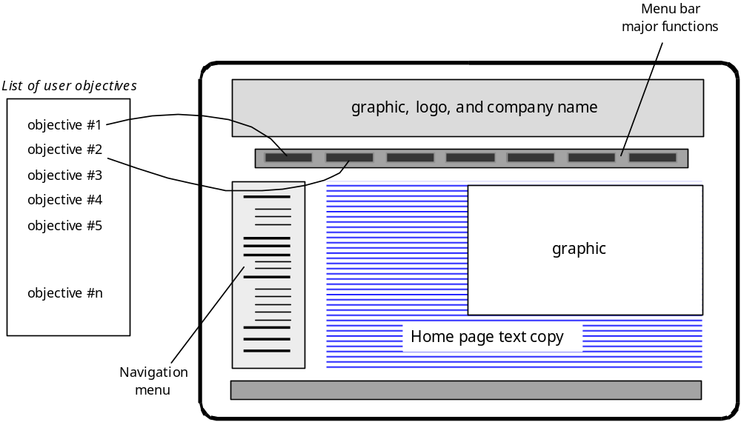
Mapping User Objectives

Slide 64
Interface Design Workflow-II
Identify user interface objects that are required to implement the interface.
Develop a procedural representation of the user’s interaction with the interface.
Develop a behavioral representation of the interface.
Describe the interface layout for each state.
Refine and review the interface design model.

Slide 65
Aesthetic Design
Don’t be afraid of white space.
Emphasize content.
Organize layout elements from top-left to bottom right.
Group navigation, content, and function geographically within the page.
Don’t extend your real estate with the scrolling bar.
Consider resolution and browser window size when designing layout.

Slide 66
Content Design
Develops a design representation for content objects
  For WebApps, a content object is more closely aligned with a data object for conventional software
Represents the mechanisms required to instantiate their relationships to one another.
  analogous to the relationship between analysis classes and design components described in Chapter 11
A content object has attributes that include content-specific information and implementation-specific attributes that are specified as part of design

Slide 67
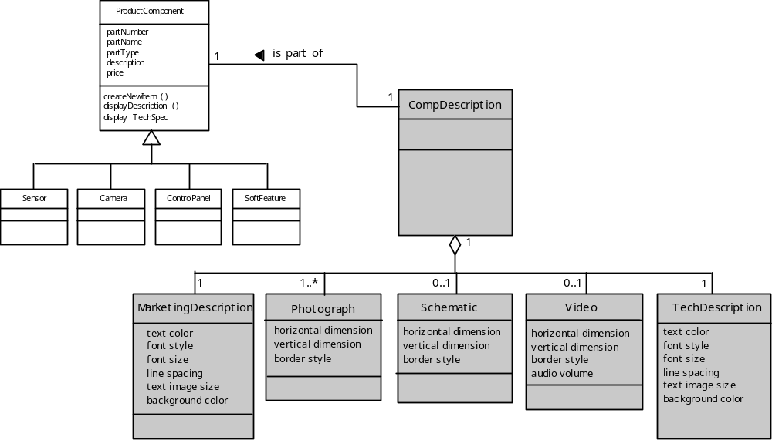
Design of Content Objects

Slide 68
Architecture Design
Content architecture focuses on the manner in which content objects (or composite objects such as Web pages) are structured for presentation and navigation.
  The term information architecture is also used to connote structures that lead to better organization, labeling, navigation, and searching of content objects.
WebApp architecture addresses the manner in which the application is structured to manage user interaction, handle internal processing tasks, effect navigation, and present content.
Architecture design is conducted in parallel with interface design, aesthetic design and content design.

Slide 69
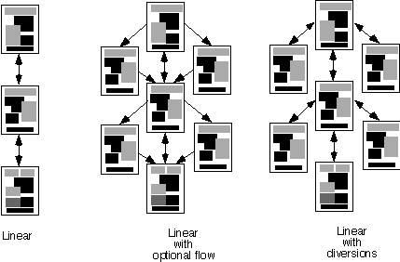
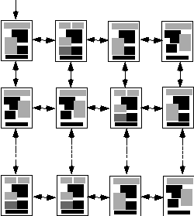
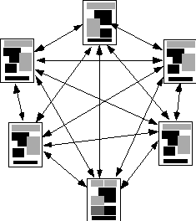
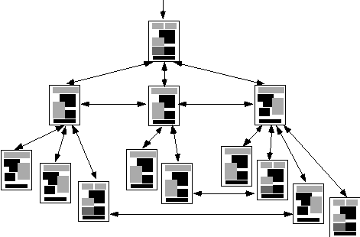
Content Architecture
Linear
structure
Grid
structure
Network
structure
Hierarchical
structure

Slide 70
MVC Architecture
The model contains all application specific content and processing logic, including
  all content objects
  access to external data/information sources,
  all processing functionality that are application specific
The view contains all interface specific functions and enables
  the presentation of content and processing logic
  access to external data/information sources,
  all processing functionality required by the end-user.
The controller manages access to the model and the view and coordinates the flow of data between them.

Slide 71
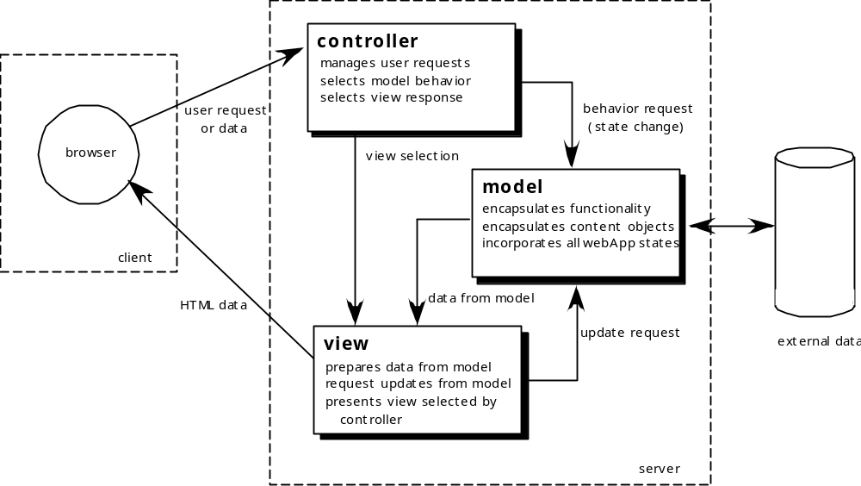
MVC Architecture

Slide 72
Navigation Design
Begins with a consideration of the user hierarchy and related use-cases
  Each actor may use the WebApp somewhat differently and therefore have different navigation requirements
As each user interacts with the WebApp, she encounters a series of navigation semantic units (NSUs)
  NSU—“a set of information and related navigation structures that collaborate in the fulfillment of a subset of related user requirements”

Slide 73
Navigation Semantic Units
Navigation semantic unit
  Ways of navigation (WoN)—represents the best navigation way or path for users with certain profiles to achieve their desired goal or sub-goal. Composed of …
    Navigation nodes (NN) connected by Navigation links
link₁₂
NN₂
link₂₄
NN₁
NN₄
NSU
link₁₃
NN₃
link₃₄

Slide 74
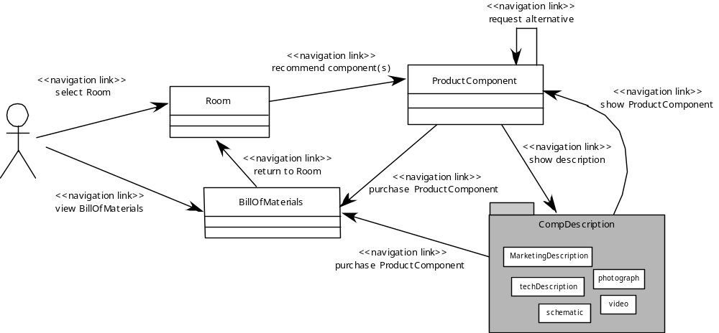
Creating an NSU

Slide 75
Navigation Syntax
    Individual navigation link—text-based links, icons, buttons and switches, and graphical metaphors..
    Horizontal navigation bar—lists major content or functional categories in a bar containing appropriate links. In general, between 4 and 7 categories are listed.
    Vertical navigation column
      lists major content or functional categories
      lists virtually all major content objects within the WebApp.
    Tabs—a metaphor that is nothing more than a variation of the navigation bar or column, representing content or functional categories as tab sheets that are selected when a link is required.
    Site maps—provide an all-inclusive tab of contents for navigation to all content objects and functionality contained within the WebApp.

Slide 76
Component-Level Design
WebApp components implement the following functionality
  perform localized processing to generate content and navigation capability in a dynamic fashion
  provide computation or data processing capability that are appropriate for the WebApp’s business domain
  provide sophisticated database query and access
  establish data interfaces with external corporate systems.

Slide 77
Hypermedia Design Patterns-I
Architectural patterns.
  assist in the design of content and WebApp architecture
  many architectural patterns are available (e.g., Java Blueprints at java.sun.com/blueprints/)
Component construction patterns.
  recommend methods for combining WebApp components (e.g., content objects, functions) into composite components.
Navigation patterns.
  assist in the design of NSUs, navigation links and the overall navigation flow of the WebApp. _

Slide 78
Hypermedia Design Patterns-II
Presentation patterns
  how to organize user interface control functions for better usability
  how to show the relationship between a interface action and the content objects it affects
  how to establish effective content hierarchies, and many others.
Behavior/user interaction patterns
  how the interface informs the user of the consequences of a specific action
  how a user expands content based on usage context and user desires
  how to best describe the destination that is implied by a link
  how to inform the user about the status of an on-going interaction, and others.

Slide 79
Patterns Repositories
Hypermedia Design Patterns Repository
  http://www.designpattern.lu.unisi.ch/
InteractionPatterns by TomErickson
  http://www.pliant.org/personal/Tom_Erickson/InteractionPatterns.html
Web Design Patterns by Martijn vanWelie
  http://www.welie.com/patterns/
Improving Web Information Systems with Navigational Patterns
  http://www8.org/w8-papers/5b-hypertext-media/improving/improving.html
An HTML 2.0 Pattern Language
  http://www.anamorph.com/docs/patterns/default.html
Common Ground - A Pattern Language for HCI Design
  http://www.mit.edu/~jtidwell/interaction_patterns.html
Patterns for Personal Web Sites
  http://www.rdrop.com/~half/Creations/Writings/Web.patterns/index.html
Indexing Pattern Language
  http://www.cs.brown.edu/~rms/InformationStructures/Indexing/Overview.html

Slide 80
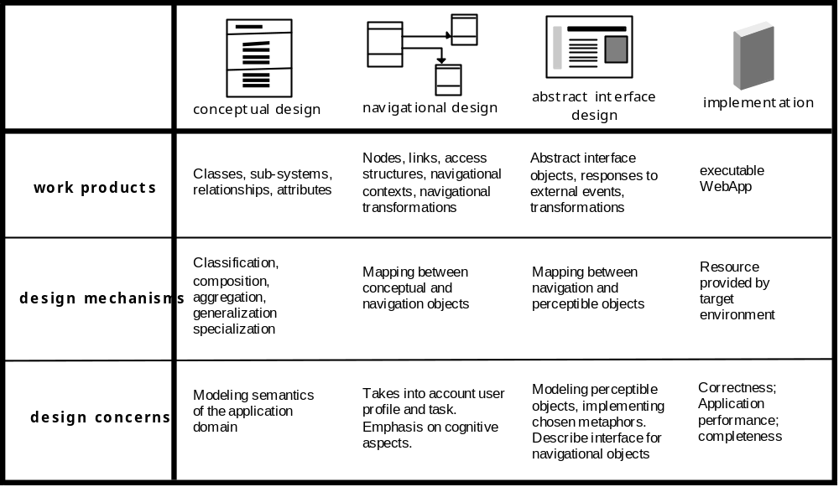
OOHDM
Object-Oriented Hypermedia Design Method (OOHDM)

Slide 81
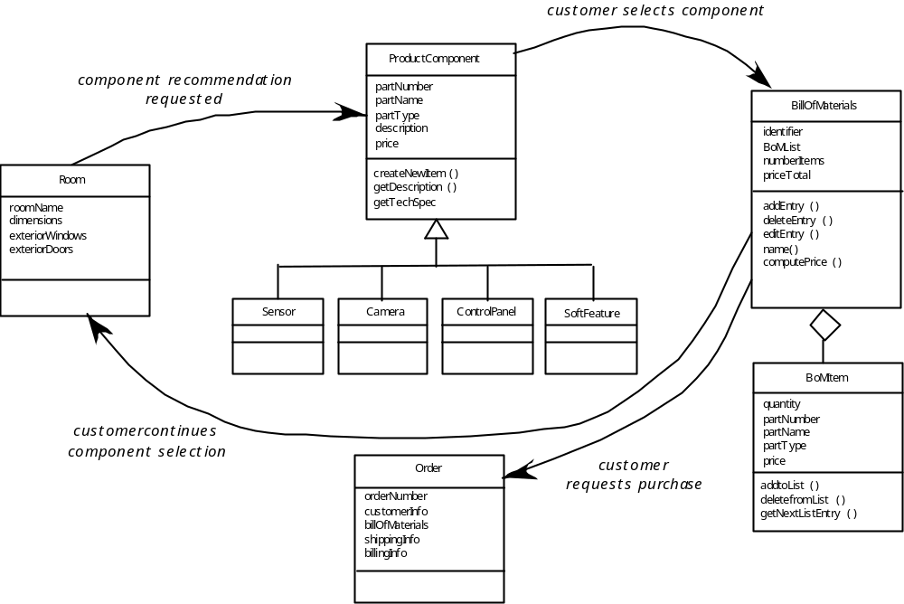
Conceptual Schema

Slide 82
Design Metrics
Does the user interface promote usability?
Are the aesthetics of the WebApp appropriate for the application domain and pleasing to the user?
Is the content designed in a manner that imparts the most information with the least effort?
Is navigation efficient and straightforward?
Has the WebApp architecture been designed to accommodate the special goals and objectives of WebApp users, the structure of content and functionality, and the flow of navigation required to use the system effectively?
Are components designed in a manner that reduces procedural complexity and enhances the correctness, reliability and performance?

Slide 83
Chapter 20
Testing Web Applications

Slide 84
Testing Quality Dimensions-I
Content is evaluated at both a syntactic and semantic level.
  syntactic level—spelling, punctuation and grammar are assessed for text-based documents.
  semantic level—correctness (of information presented), consistency (across the entire content object and related objects) and lack of ambiguity are all assessed.
Function is tested for correctness, instability, and general conformance to appropriate implementation standards (e.g.,Java or XML language standards).
Structure is assessed to ensure that it
  properly delivers WebApp content and function
  is extensible
  can be supported as new content or functionality is added.

Slide 85
Testing Quality Dimensions-II
Usability is tested to ensure that each category of user
  is supported by the interface
  can learn and apply all required navigation syntax and semantics
Navigability is tested to ensure that
  all navigation syntax and semantics are exercised to uncover any navigation errors (e.g., dead links, improper links, erroneous links).
Performance is tested under a variety of operating conditions, configurations, and loading to ensure that
  the system is responsive to user interaction
  the system handles extreme loading without unacceptable operational degradation

Slide 86
Testing Quality Dimensions-III
Compatibility is tested by executing the WebApp in a variety of different host configurations on both the client and server sides.
  The intent is to find errors that are specific to a unique host configuration.
Interoperability is tested to ensure that the WebApp properly interfaces with other applications and/or databases.
Security is tested by assessing potential vulnerabilities and attempting to exploit each.
  Any successful penetration attempt is deemed a security failure.

Slide 87
WebApp Testing Strategy-I
The content model for the WebApp is reviewed to uncover errors.
The interface model is reviewed to ensure that all use-cases can be accommodated.
The design model for the WebApp is reviewed to uncover navigation errors.
The user interface is tested to uncover errors in presentation and/or navigation mechanics.
Selected functional components are unit tested.

Slide 88
WebApp Testing Strategy-II
Navigation throughout the architecture is tested.
The WebApp is implemented in a variety of different environmental configurations and is tested for compatibility with each configuration.
Security tests are conducted in an attempt to exploit vulnerabilities in the WebApp or within its environment.
Performance tests are conducted.
The WebApp is tested by a controlled and monitored population of end-users
  the results of their interaction with the system are evaluated for content and navigation errors, usability concerns, compatibility concerns, and WebApp reliability and performance.

Slide 89
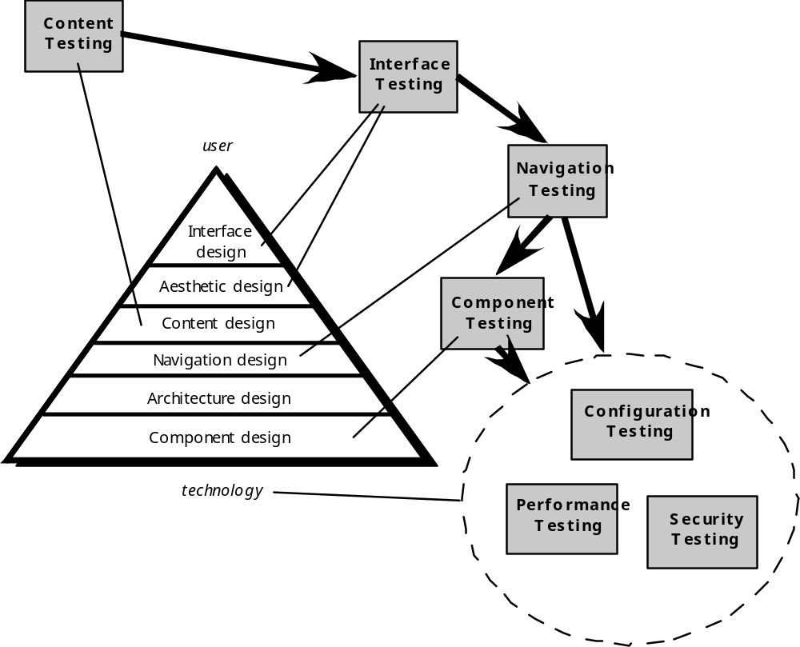
The Testing Process

Slide 90
Content Testing
Content testing has three important objectives:
  to uncover syntactic errors (e.g., typos, grammar mistakes) in text-based documents, graphical representations, and other media
  to uncover semantic errors (i.e., errors in the accuracy or completeness of information) in any content object presented as navigation occurs, and
  to find errors in the organization or structure of content that is presented to the end-user.

Slide 91
Assessing Content Semantics
Is the information factually accurate?
Is the information concise and to the point?
Is the layout of the content object easy for the user to understand?
Can information embedded within a content object be found easily?
Have proper references been provided for all information derived from other sources?
Is the information presented consistent internally and consistent with information presented in other content objects?
Is the content offensive, misleading, or does it open the door to litigation?
Does the content infringe on existing copyrights or trademarks?
Does the content contain internal links that supplement existing content? Are the links correct?
Does the aesthetic style of the content conflict with the aesthetic style of the interface?

Slide 92
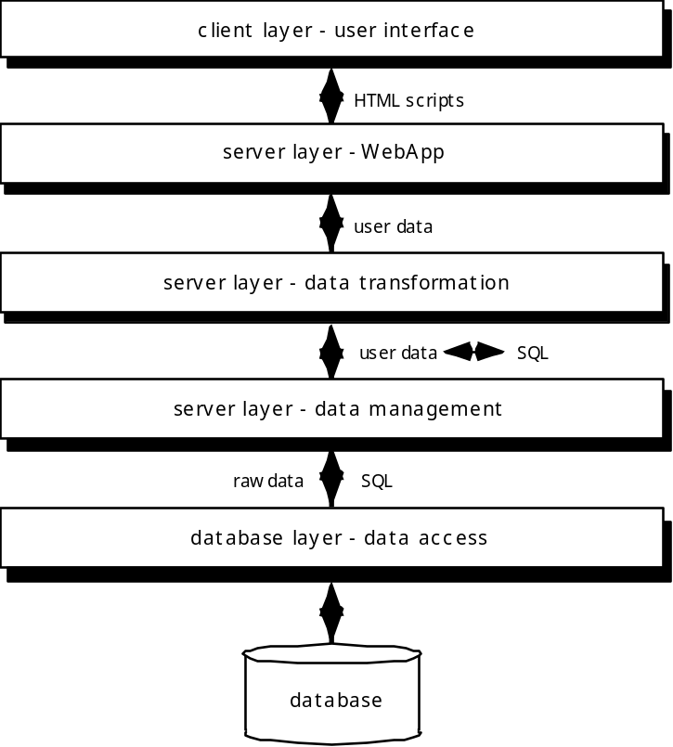
Database Testing
Tests are defined for
each layer

Slide 93
User Interface Testing
Interface features are tested to ensure that design rules, aesthetics, and related visual content is available for the user without error.
Individual interface mechanisms are tested in a manner that is analogous to unit testing.
Each interface mechanism is tested within the context of a use-case or NSU (Chapter 19) for a specific user category.
The complete interface is tested against selected use-cases and NSUs to uncover errors in the semantics of the interface.
The interface is tested within a variety of environments (e.g., browsers) to ensure that it will be compatible.

Slide 94
Testing Interface Mechanisms-I
Links—navigation mechanisms that link the user to some other content object or function.
Forms—a structured document containing blank fields that are filled in by the user. The data contained in the fields are used as input to one or more WebApp functions.
Client-side scripting—a list of programmed commands in a scripting language (e.g., Javascript) that handle information input via forms or other user interactions
Dynamic HTML—leads to content objects that are manipulated on the client side using scripting or cascading style sheets (CSS).
Client-side pop-up windows—small windows that pop-up without user interaction. These windows can be content-oriented and may require some form of user interaction.

Slide 95
Testing Interface Mechanisms-II
CGI scripts—a common gateway interface (CGI) script implements a standard method that allows a Web server to interact dynamically with users (e.g., a WebApp that contains forms may use a CGI script to process the data contained in the form once it is submitted by the user).
Streaming content—rather than waiting for a request from the client-side, content objects are downloaded automatically from the server side. This approach is sometimes called “push” technology because the server pushes data to the client.
Cookies—a block of data sent by the server and stored by a browser as a consequence of a specific user interaction. The content of the data is WebApp-specific (e.g., user identification data or a list of items that have been selected for purchase by the user).
Application specific interface mechanisms—include one or more “macro” interface mechanisms such as a shopping cart, credit card processing, or a shipping cost calculator.

Slide 96
Usability Tests
Design by WebE team … executed by end-users
Testing sequence …
  Define a set of usability testing categories and identify goals for each.
  Design tests that will enable each goal to be evaluated.
  Select participants who will conduct the tests.
  Instrument participants’ interaction with the WebApp while testing is conducted.
  Develop a mechanism for assessing the usability of the WebApp
different levels of abstraction:
  the usability of a specific interface mechanism (e.g., a form) can be assessed
  the usability of a complete Web page (encompassing interface mechanisms, data objects and related functions) can be evaluated
  the usability of the complete WebApp can be considered.

Slide 97
Compatibility Testing
Compatibility testing is to define a set of “commonly encountered” client side computing configurations and their variants
Create a tree structure identifying
  each computing platform
  typical display devices
  the operating systems supported on the platform
  the browsers available
  likely Internet connection speeds
  similar information.
Derive a series of compatibility validation tests
  derived from existing interface tests, navigation tests, performance tests, and security tests.
  intent of these tests is to uncover errors or execution problems that can be traced to configuration differences.

Slide 98
Component-Level Testing
Focuses on a set of tests that attempt to uncover errors in WebApp functions
Conventional black-box and white-box test case design methods can be used
Database testing is often an integral part of the component-testing regime

Slide 99
Navigation Testing
The following navigation mechanisms should be tested:
  Navigation links—these mechanisms include internal links within the WebApp, external links to other WebApps, and anchors within a specific Web page.
  Redirects—these links come into play when a user requests a non-existent URL or selects a link whose destination has been removed or whose name has changed.
  Bookmarks—although bookmarks are a browser function, the WebApp should be tested to ensure that a meaningful page title can be extracted as the bookmark is created.
  Frames and framesets—tested for correct content, proper layout and sizing, download performance, and browser compatibility
  Site maps—Each site map entry should be tested to ensure that the link takes the user to the proper content or functionality.
  Internal search engines—Search engine testing validates the accuracy and completeness of the search, the error-handling properties of the search engine, and advanced search features

Slide 100
Testing Navigation Semantics-I
Is the NSU achieved in its entirety without error?
Is every navigation node (defined for a NSU) reachable within the context of the navigation paths defined for the NSU?
If the NSU can be achieved using more than one navigation path, has every relevant path been tested?
If guidance is provided by the user interface to assist in navigation, are directions correct and understandable as navigation proceeds?
Is there a mechanism (other than the browser ‘back’ arrow) for returning to the preceding navigation node and to the beginning of the navigation path.
Do mechanisms for navigation within a large navigation node (i.e., a long web page) work properly?
If a function is to be executed at a node and the user chooses not to provide input, can the remainder of the NSU be completed?

Slide 101
Testing Navigation Semantics-II
If a function is executed at a node and an error in function processing occurs, can the NSU be completed?
Is there a way to discontinue the navigation before all nodes have been reached, but then return to where the navigation was discontinued and proceed from there?
Is every node reachable from the site map? Are node names meaningful to end-users?
If a node within an NSU is reached from some external source, is it possible to process to the next node on the navigation path. Is it possible to return to the previous node on the navigation path?
Does the user understand his location within the content architecture as the NSU is executed?

Slide 102
Configuration Testing
Server-side
  Is the WebApp fully compatible with the server OS?
  Are system files, directories, and related system data created correctly when the WebApp is operational?
  Do system security measures (e.g., firewalls or encryption) allow the WebApp to execute and service users without interference or performance degradation?
  Has the WebApp been tested with the distributed server configuration (if one exists) that has been chosen?
  Is the WebApp properly integrated with database software? Is the WebApp sensitive to different versions of database software?
  Do server-side WebApp scripts execute properly?
  Have system administrator errors been examined for their affect on WebApp operations?
  If proxy servers are used, have differences in their configuration been addressed with on-site testing?

Slide 103
Configuration Testing
Client-side
  Hardware—CPU, memory, storage and printing devices
  Operating systems—Linux, Macintosh OS, Microsoft Windows, a mobile-based OS
  Browser software—Internet Explorer, Mozilla/Netscape, Opera, Safari, and others
  User interface components—Active X, Java applets and others
  Plug-ins—QuickTime, RealPlayer, and many others
  Connectivity—cable, DSL, regular modem, T1
The number of configuration variables must be reduced to a manageable number

Slide 104
Security Testing
Designed to probe vulnerabilities of the client-side environment, the network communications that occur as data are passed from client to server and back again, and the server-side environment
On the client-side, vulnerabilities can often be traced to pre-existing bugs in browsers, e-mail programs, or communication software.
On the server-side, vulnerabilities include denial-of-service attacks and malicious scripts that can be passed along to the client-side or used to disable server operations

Slide 105
Performance Testing
Does the server response time degrade to a point where it is noticeable and unacceptable?
At what point (in terms of users, transactions or data loading) does performance become unacceptable?
What system components are responsible for performance degradation?
What is the average response time for users under a variety of loading conditions?
Does performance degradation have an impact on system security?
Is WebApp reliability or accuracy affected as the load on the system grows?
What happens when loads that are greater than maximum server capacity are applied?

Slide 106
Load Testing
The intent is to determine how the WebApp and its server-side environment will respond to various loading conditions
  N, the number of concurrent users
  T, the number of on-line transactions per unit of time
  D, the data load processed by the server per transaction
Overall throughput, P, is computed in the following manner:
    P = N x T x D

Slide 107
Stress Testing
Does the system degrade ‘gently’ or does the server shut down as capacity is exceeded?
Does server software generate “server not available” messages? More generally, are users aware that they cannot reach the server?
Does the server queue requests for resources and empty the queue once capacity demands diminish?
Are transactions lost as capacity is exceeded?
Is data integrity affected as capacity is exceeded?
What values of N, T, and D force the server environment to fail? How does failure manifest itself? Are automated notifications sent to technical support staff at the server site?
If the system does fail, how long will it take to come back on-line?
Are certain WebApp functions (e.g., compute intensive functionality, data streaming capabilities) discontinued as capacity reaches the 80 or 90 percent level?

